Slide 1
Project 2: Drug Abuse Database Application
Chao-Chin, Liu
Avery, Bai

Slide 2
Problem Background
NIH's Biggest Health Challenges - Opioid Addiction
The opioid crisis, involving prescription painkillers, heroin, and synthetic opioids like fentanyl, has become a national emergency with significant impacts^{1, 2}, especially on military personnel and veterans, costing over $504 billion annually in the U.S^{3, 8}.
NIH research has led to life-saving strategies and treatments for opioid addiction. The surge in prescribing opioids for chronic pain, despite their risks and questionable long-term efficacy, underscores the need for better pain management options^{4,5}.
We want to use the data from the CDC’s Drug Overdose Surveillance and Epidemiology system, which captures both emergency department (ED) and inpatient hospitalization discharge data (HOSP) from jurisdictions, to understand more about the nonfatal opioid addiction crisis.

Slide 3
4 Datasets
You can delete this slide when you’re done editing the presentation
Fatal Overdose Data | https://www.cdc.gov/drugoverdose/fatal/sudors.html
Nonfatal Overdose Syndromic Surveillance Data | https://www.cdc.gov/nssp/overview.html
Nonfatal Overdose Emergency Department and Inpatient Hospitalization Discharge Data | https://www.cdc.gov/drugoverdose/nonfatal/dose/about.html
Federal Information Processing System (FIPS) Codes for States and Counties | https://transition.fcc.gov/oet/info/maps/census/fips/fips.txt
State Population Totals: 2010-2019 | https://www.census.gov/data/datasets/time-series/demo/popest/2010s-state-total.html
State Population Totals and Components of Change: 2020-2023 | https://www.census.gov/data/tables/time-series/demo/popest/2020s-state-total.html
We did not use the Fatal Overdose Database in this project.

Slide 4
Data Cleaning Process - Excel
Drop unrepresentative data, e.g. partial disclosed data record.
Split some tables and fix structural errors.
→non-key attributes fully depend on candidate keys(2NF)
1
2
3
4
5
Remove duplicate or irrelevant data.
→ single-valued attribute(1NF)
Handle Missing Data
Remove some attribute that could be calculated from given data, e.g. yearly data.
→no transitive dependency(3NF)
→the determinants X are all superkeys of R (BCNF)
Notes:
Avery

Slide 5
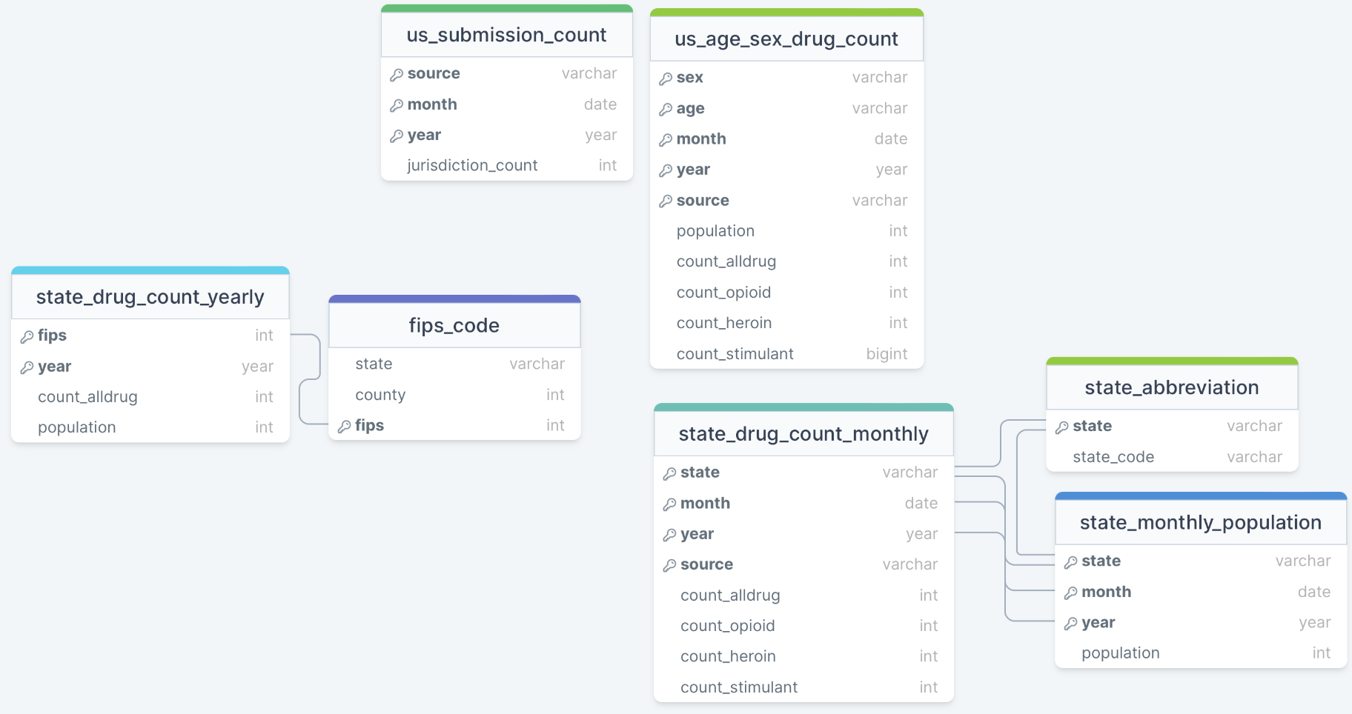
Dataset Scheme
Notes:
Avery

Slide 6
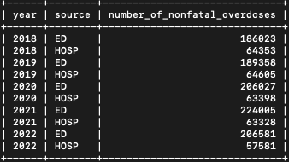
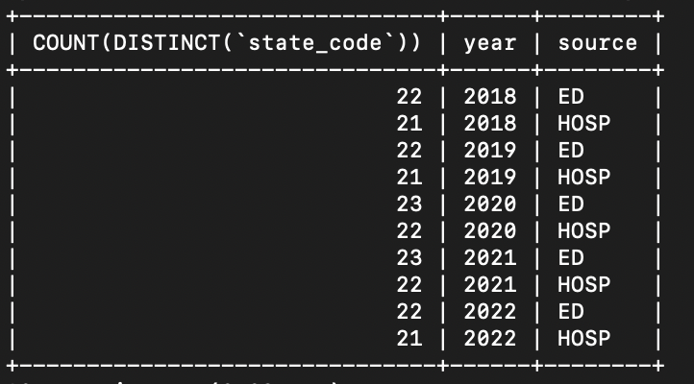
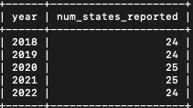
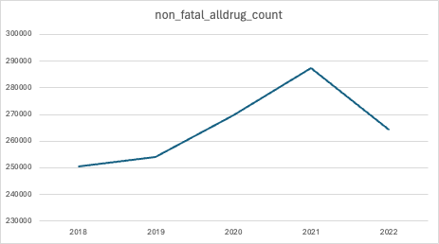
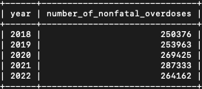
Data Trends Study - Understand our data
Q1: Annual number of nonfatal all-drug overdoses in ED and HOSP each year? In Both?
SELECT `year`, `source`, SUM(`count_alldrug`) AS `number_of_nonfatal_overdoses` FROM DBMSProject2.sex_age_drug_count GROUP BY `year`, `source`;
Q2: How many state participate in submission?
SELECT COUNT(DISTINCT(`state_code`)), `year`, `source` FROM DBMSProject2.state_drug_count GROUP BY `year`, `source`; SELECT year, COUNT(DISTINCT(`state_code`)) AS `num_states_reported` FROM DBMSProject2.state_drug_count GROUP BY `year`
What happen in 2021?
Could be Covid⁶
Burgess-Hull AJ, Smith KE, Panlilio LV, Schriefer D, Preston KL, Alter A, Yeager C, Chizmar T, Delbridge T, Zamore K, Beeson J, Epstein DH. Nonfatal opioid overdoses before and after Covid-19: Regional variation in rates of change. PLoS One. 2022 Mar 9;17(3):e0263893. doi: 10.1371/journal.pone.0263893. PMID: 35263326; PMCID: PMC8906602.
Moghtaderi A, Zocchi MS, Pines JM, Venkat A, Black B. Estimating the uncertain effect of the COVID pandemic on drug overdoses. PLoS One. 2023 Aug 10;18(8):e0281227. doi: 10.1371/journal.pone.0281227. PMID: 37561686; PMCID: PMC10414597.

Slide 7
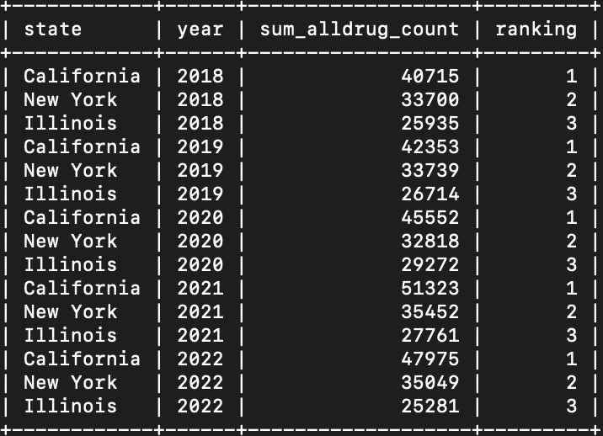
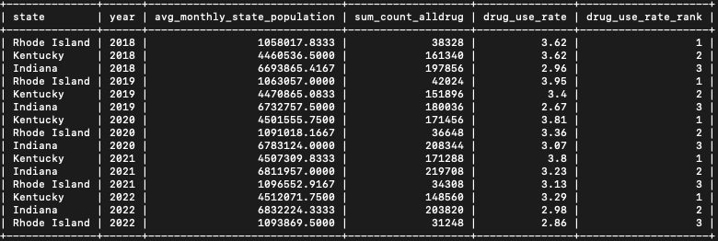
Geographic nonfatal overdose study
Q3: From 2018-2022, states which have top 3 nonfatal yearly overdose count?
Q4: The nonfatal overdose rate? Is the top 3 states same as 3 non-fatal overdose count?
Raking change after we rank the table by the drug use rate.
RI: socioeconomic challenges, the availability of opioids, and systemic issues in healthcare access and treatment, KT: prevalence of potent drugs such as fentanyl and methamphetamine.⁷
SELECT * FROM ( SELECT sa.`state`, sdc.`year`, SUM(sdc.`count_alldrug`) AS sum_alldrug_count, rank() OVER (PARTITION BY `year` ORDER BY (SUM(`count_alldrug`)) DESC) AS `ranking` FROM DBMSProject2.state_drug_count sdc LEFT JOIN DBMSProject2.state_abbreviation sa ON sdc.`state_code` = sa.`state_code` GROUP BY sdc.`state_code`, sdc.`year`) AS temp_table WHERE temp_table.`ranking` <=3;
SELECT * FROM ( SELECT sa.`state`, sdc.`year`, AVG(sp.`monthly_state_population`) AS avg_monthly_state_population, SUM(sdc.`count_alldrug`) AS sum_count_alldrug, ROUND(SUM(sdc.`count_alldrug`)/AVG(sp.`monthly_state_population`)*100, 2) AS `drug_use_rate`, RANK() OVER ( PARTITION BY sdc.`year` ORDER BY SUM(sdc.`count_alldrug`)/AVG(sp.`monthly_state_population`) DESC ) AS `drug_use_rate_rank` FROM DBMSProject2.state_drug_count sdc LEFT JOIN DBMSProject2.state_population sp ON sdc.`year` = sp.`year` AND sdc.`state_code` = sp.`state_code` LEFT JOIN DBMSProject2.state_abbreviation sa ON sdc.`state_code` = sa.`state_code` GROUP BY sdc.`state_code`, sdc.`year` ) AS temp_table WHERE temp_table.`drug_use_rate_rank` <= 3;
Why Top3 is always CA, NY, IL?
Because of the population size?
https://www.bostonfed.org/news-and-events/news/2021/01/addressing-rhode-island-opioid-crisis-neppc.aspx
Notes:
Rhode Island's opioid crisis is deeply rooted in complex factors including socioeconomic challenges, the availability of opioids, and systemic issues in healthcare access and treatment. Innovative efforts and policies have been developed in response, yet the state continues to face high rates of nonfatal overdoses, highlighting the persistent and multifaceted nature of the crisis.
Kentucky's high nonfatal overdose rate is largely attributed to a combination of factors, including the prevalence of potent drugs such as fentanyl and methamphetamine, the opioid epidemic, and socioeconomic conditions. The 2021 Kentucky Drug Overdose Report highlights the increased use of fentanyl as the largest contributor to the rise in overdose deaths, with fentanyl accounting for approximately 70% of all overdose deaths for that year. The widespread availability of potent, inexpensive methamphetamine also worsened the situation​

Slide 8
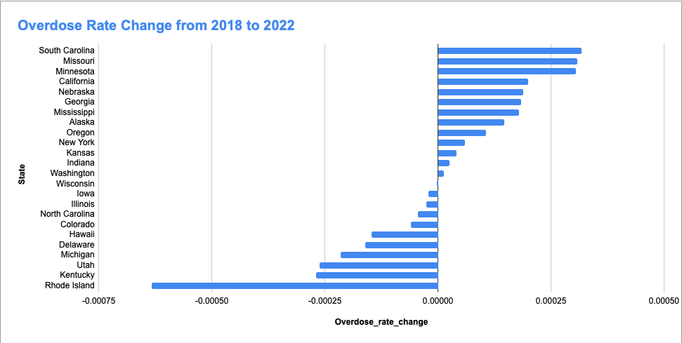
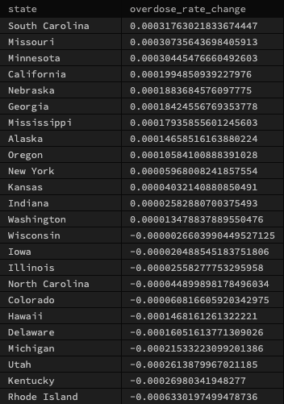
Geographic nonfatal overdose study
Q5: From 2018 to 2022, How did the overdose rate change by states?
Q6: Which two states had increased overdose rate, and which two states had decrease overdose rate?
SELECT state_abbreviation.state, Table4.overdose_rate-Table3.overdose_rate AS overdose_rate_change FROM ( SELECT Table1.state_code, Table1.yearly_alldrug/Table2.monthly_state_population AS overdose_rate FROM (SELECT state_code, SUM(count_alldrug) AS yearly_alldrug FROM state_drug_count WHERE year = 2018 GROUP BY state_code) AS Table1 RIGHT JOIN (SELECT state_code, monthly_state_population FROM state_population WHERE month = 12 AND year = 2018) AS Table2 ON Table1.state_code = Table2.state_code) AS Table3 INNER JOIN ( SELECT Table1.state_code, Table1.yearly_alldrug/Table2.monthly_state_population AS overdose_rate FROM (SELECT state_code, SUM(count_alldrug) AS yearly_alldrug FROM state_drug_count WHERE year = 2022 GROUP BY state_code) AS Table1 RIGHT JOIN (SELECT state_code, monthly_state_population FROM state_population WHERE month = 12 AND year = 2022) AS Table2 ON Table1.state_code = Table2.state_code) As Table4 ON Table3.state_code = Table4.state_code INNER JOIN state_abbreviation ON state_abbreviation.state_code = Table3.state_code ORDER BY overdose_rate_change DESC;
Notes:
Avery: sql query: in progress

Slide 9
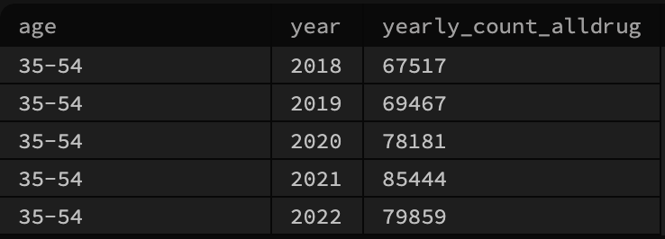
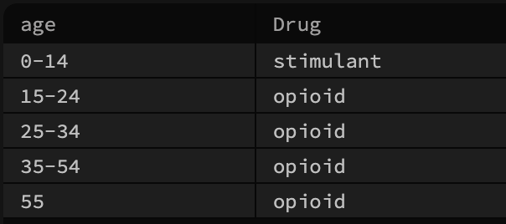
Demographic nonfatal overdose study:
Q7: Which age group has the highest overdose
count from 2018 to 2022?
Q8: What type of drug did the patient overdose on the most across different age groups?
SELECT TempTable.age AS age, TempTable.year AS year, TempTable.yearly_alldrug AS yearly_count_alldrug FROM (SELECT age, year, SUM(count_alldrug) AS yearly_alldrug FROM sex_age_drug_count GROUP BY age, year) AS TempTable RIGHT JOIN (SELECT MAX(TempTable1.yearly_alldrug)AS age_max FROM (SELECT age, year, SUM(count_alldrug) AS yearly_alldrug FROM sex_age_drug_count GROUP BY age,year)AS TempTable1 GROUP BY year) AS TempTable2 ON TempTable.yearly_alldrug = TempTable2.age_max;
SELECT age, CASE WHEN GREATEST(SUM(count_opioid), SUM(count_heroin), SUM(count_stimulant)) = SUM(count_opioid) THEN 'opioid' WHEN GREATEST(SUM(count_opioid), SUM(count_heroin), SUM(count_stimulant)) = SUM(count_heroin) THEN 'heroin' WHEN GREATEST(SUM(count_opioid), SUM(count_heroin), SUM(count_stimulant)) = SUM(count_stimulant) THEN 'stimulant' END AS Drug FROM ( SELECT age, year, SUM(count_opioid) as count_opioid, SUM(count_heroin) as count_heroin, SUM(count_stimulant) as count_stimulant FROM sex_age_drug_count GROUP BY age, year) AS age_drug GROUP BY age;
Notes:
Avery: sql query completed; put on slide[in-progress]

Slide 10


Fatal Data study
Q: Annual number of fatal all-drug overdoses in ED and HOSP each year? Compare to nonfatal data?
SELECT `year`, SUM(`alldrug_deaths`) AS `number_of_fatal_overdoses` FROM DBMSProject2FatalData.all_drug_death_count GROUP BY `year`;
SELECT `year`, SUM(`alldrug_deaths`) AS `number_of_fatal_overdoses` FROM DBMSProject2FatalData.all_drug_death_count GROUP BY `year`;
Fatal Data: 37 states v.s Non Fatal Data: 20 states.
Maybe we should not compare the number in these 2 dataset.
System difference, more resources or interest in fatal outcome monitoring, potential bias
Notes:
System Differences: The difference in submission could reflect variations in the data collection systems used for fatal and non-fatal data. These systems may have different requirements, reporting incentives, or capacities that affect how states participate. For example, fatal data collection systems might be more integrated with vital statistics and death certificates, making it easier or more mandatory for states to report. In contrast, non-fatal data might depend on hospital reporting or other health surveillance systems, which could be more fragmented or voluntary.
Reporting Incentives and Resources: The discrepancy could also highlight differences in reporting incentives or resources among states. States that have more resources or a particular interest in monitoring fatal outcomes might be more likely to report fatal data. Conversely, non-fatal data collection might require more resources (e.g., for hospital data collection and processing), leading to fewer states participating due to resource constraints.
Data Reliability and Comparability: This discrepancy underscores the challenges in comparing these datasets directly. Differences in coverage, definitions of what constitutes a reportable case, and data collection methods can all influence the datasets' reliability and comparability. Analysts should be wary of making direct comparisons without accounting for these factors.
Policy and Public Health Implications: The variation in reporting might indicate areas where public health interventions or policies could be improved. For instance, if certain states are underrepresented in non-fatal data collection, there might be an opportunity to enhance surveillance systems or support those states in boosting their reporting capabilities.
Potential Bias: Finally, the difference in the number of states reporting could introduce bias into analyses. If the states reporting fatal data, for example, are systematically different from those reporting non-fatal data (e.g., by geography, population size, or health infrastructure), this could skew the understanding of public health issues.

Slide 11
Reference
Federal Communications Commission. (n.d.). Focus on opioids - Connect2Health. FCC. https://www.fcc.gov/reports-research/maps/connect2health/focus-on-opioids.htm
Compton, W. M., & Jones, C. M. (2019). Epidemiology of the U.S. opioid crisis: the importance of the vector. Annals of the New York Academy of Sciences, 1451(1), 130–143. https://doi.org/10.1111/nyas.14209
Bennett, A. S., Guarino, H., Britton, P. C., O'Brien-Mazza, D., Cook, S. H., Taveras, F., Cortez, J., & Elliott, L. (2022). U.S. Military veterans and the opioid overdose crisis: a review of risk factors and prevention efforts. Annals of medicine, 54(1), 1826–1838. https://doi.org/10.1080/07853890.2022.2092896
National Academies of Sciences, Engineering, and Medicine, Health and Medicine Division, Board on Health Sciences Policy, Committee on Pain Management and Regulatory Strategies to Address Prescription Opioid Abuse. (2017). Evidence on strategies for addressing the opioid epidemic. In J.K. Phillips, M.A. Ford, & R.J. Bonnie (Eds.), Pain Management and the Opioid Epidemic: Balancing Societal and Individual Benefits and Risks of Prescription Opioid Use (pp. [pages of the chapter]). National Academies Press. https://www.ncbi.nlm.nih.gov/books/NBK458653/
National Institutes of Health. (2014). Opioid use disorder and pain panel statement final [PDF]. Office of Disease Prevention. Retrieved from https://prevention.nih.gov/sites/default/files/documents/programs/p2p/ODPPainPanelStatementFinal_10-02-14.pdf
Burgess-Hull AJ, Smith KE, Panlilio LV, Schriefer D, Preston KL, Alter A, Yeager C, Chizmar T, Delbridge T, Zamore K, Beeson J, Epstein DH. Nonfatal opioid overdoses before and after Covid-19: Regional variation in rates of change. PLoS One. 2022 Mar 9;17(3):e0263893. doi: 10.1371/journal.pone.0263893. PMID: 35263326; PMCID: PMC8906602. Moghtaderi A, Zocchi MS, Pines JM, Venkat A, Black B. Estimating the uncertain effect of the COVID pandemic on drug overdoses. PLoS One. 2023 Aug 10;18(8):e0281227. doi: 10.1371/journal.pone.0281227. PMID: 37561686; PMCID: PMC10414597.
Federal Reserve Bank of Boston. (2021, January 5). Addressing Rhode Island’s opioid crisis. https://www.bostonfed.org/news-and-events/news/2021/01/addressing-rhode-island-opioid-crisis-neppc.aspx
U.S. Representative Don Beyer. (2022, September 28). JEC analysis finds opioid epidemic cost U.S. nearly $1.5 trillion in 2020. https://beyer.house.gov/news/documentsingle.aspx?DocumentID=5684

